Slide 1
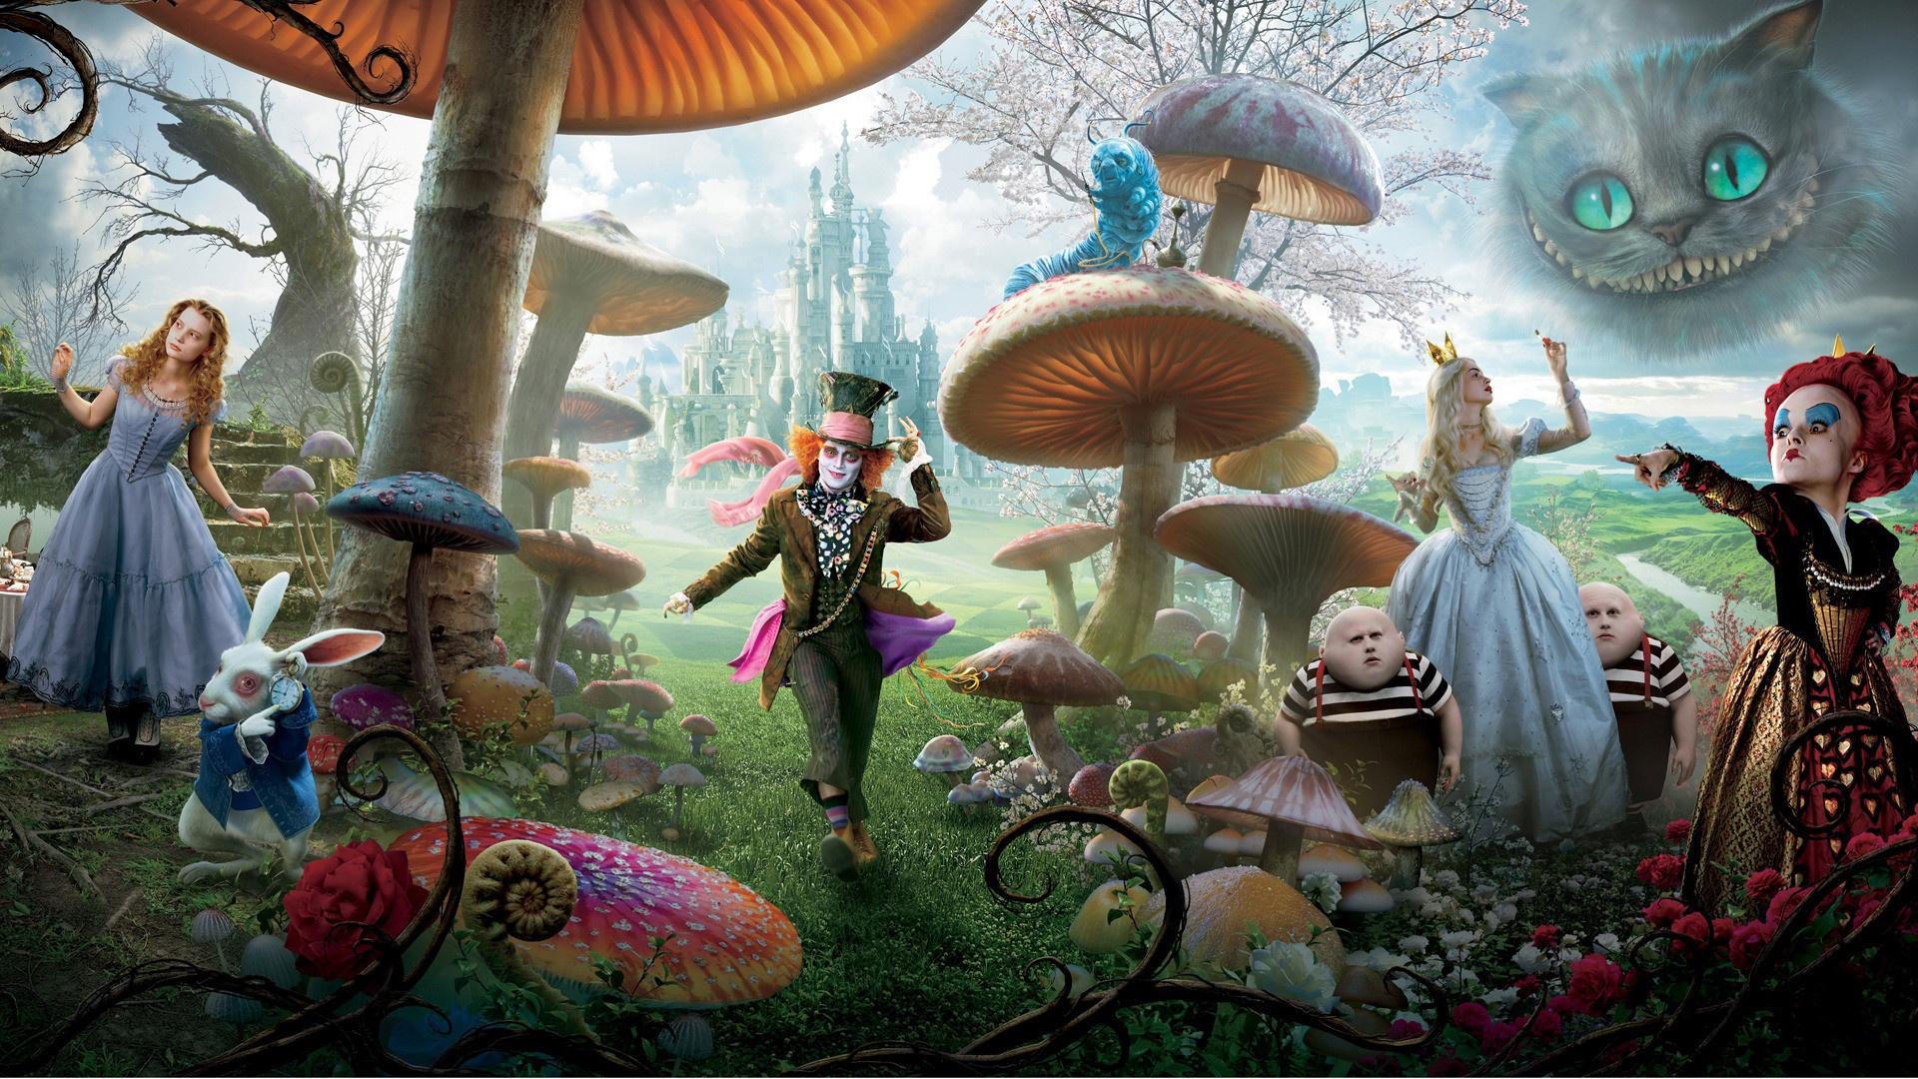
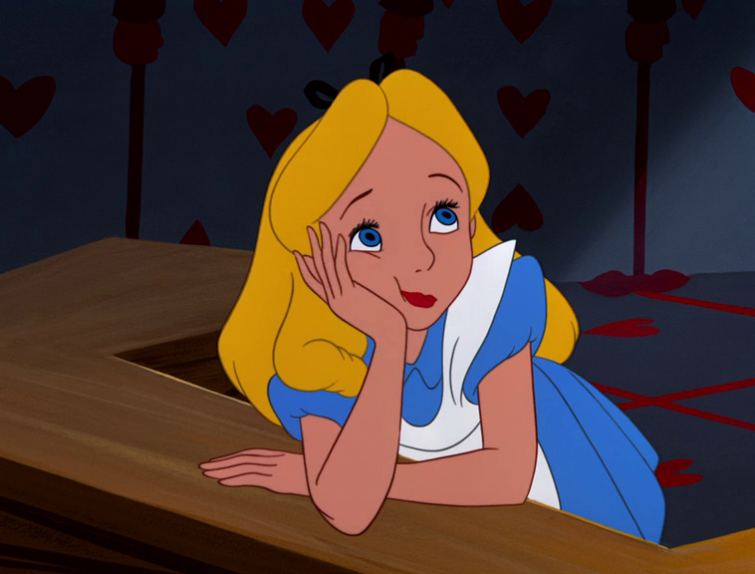
Alice in Wonderland
Alice’s adventures in Wonderland, commonly shortened to Alice in Wonderland, is an 1865 fantasy novel written by English mathematician Charles Lutwidge Dodgson under the pseudonym Lewis Carroll. It is considered to be one of the best examples of the literaly fiction genre.
At the beginnig Alice felt asleep during a history lesson and she started to dream…when she saw a white rabbit with a watch in its pawn who was runnin close to her saying:”oh dear! oh dear! I shall be too late” Alice began to follow him also through a hole in a tree, which took her to magical world full of bizarre situations, landscapes and inhabitants. At the end of the gallery she founds herself in a room with a very little locked door at the end, that portrays the obstacles you will face during your whole life. So, to pass trough it, she had to drink a liquid which reduces the size of the drinker. But the talking door, before it forgot to tell her that the key is on the table which was very tall compared to Alice. For this reason she had to eat a biscuit that trasforms her into a giant, altought she realizes that in this way she cannot go through the other side of the door, where there is the white rabbit waiting for her. After that the door suggested her to drink another time from the bottle: so she can pass trough the door. Alice saw the white rabbit and followed him in a huge forest.

Slide 2
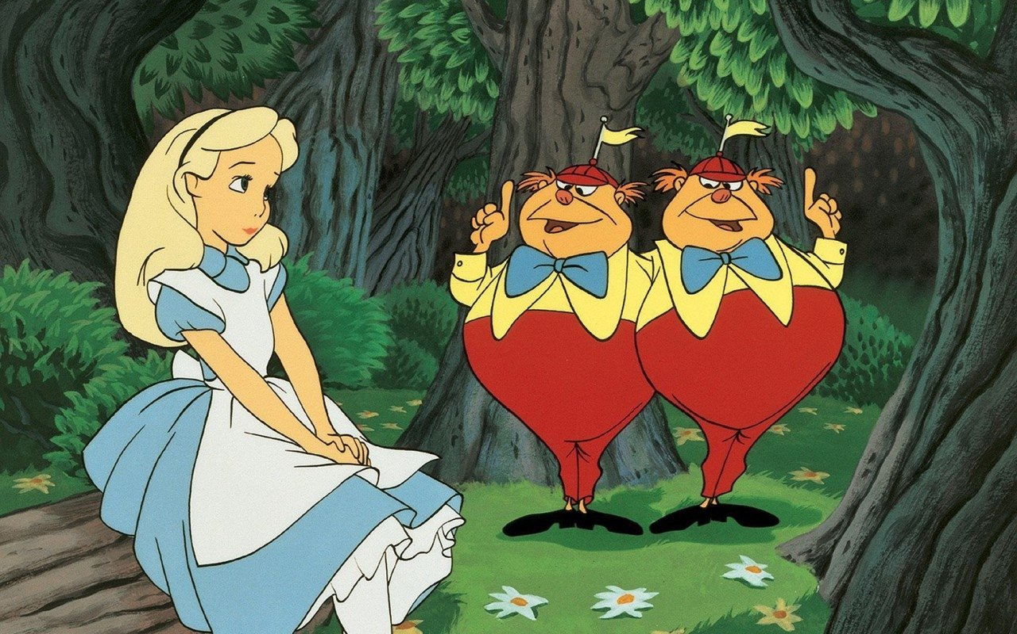
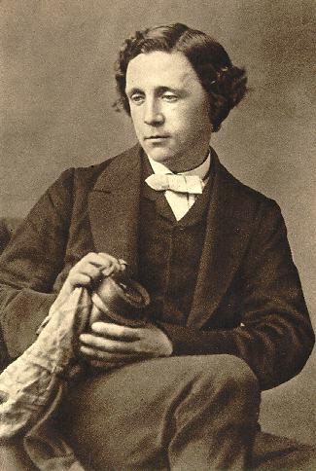
There she met two very fat and stupid twins, who to catch her attention started to tell her a story about some oysters and other curiosities. During her travels she met the Mad Hatter and the March Hare, very mad people, who were celebrating the “Not Birthday”; The blue caterpillar which made the protagonist of the story feel uneasy and angry more than all the other creatures of wonderand because of its curiosity. Then she met the Chesire cat, a cat whose chatacteristic is that he can make himself invisible, except for his bad smile, which indicated her the way to go to a castle: the one where the queen of hearts lives, she a very strange character, she is autoritarian, she always wants to be right, she changes her mood very often…Then Alice woke up discovering it was only a dream and sometimes a nightmare.
Lewis Carroll, the author of the book, hid there, with the help of metaphors, some constructive teaching useful to the whole world. For example when she started to cry in the hall with doors of all sizes, this was a metaphor which meaning is that we live in a world based above all on the conventions, the way in which something is done by most people in a society and considered to be polite or in the right way to do it, like the english tradition of the Tea. Another methaphor is the one of the huge forest, symbol of perdition, like in the Divine Comedy of Dante. Carrol wanted to move a criticism against the society of his time, where it was more important the psysical aspect, and above all the belonging to a social class, than the real personality of a human. The language used is very simple, because the will of the author was to give this book as a present to a little child, so very often, he invented strange words.
To sum up the book is an exciting story of adventure. If you love fantasy books, I would definetly recommend reading this story about this girl and her strange adventures.

